Slide 1
Enhanced Recovery After Surgery (ERAS)
A Patient Partnership for Safety Program
ERAS HEALS at Frederick Health
Surgical Services

Slide 2
ERAS HEALS Table of Contents | Page #
Welcome | 3
ERAS HEALS at Frederick Health | 4-5
Surgery is Like a Marathon | 6
What to Expect at the Hospital Before Surgery | 7-8
Mouth Care | 9
Surgical Site Infections | 10-11
Preparing Your Skin | 12-13
Deep Breathing | 14
Quit Smoking | 15-16
Diet and Nutrition | 17-18
Activity | 19-20
Pain Control | 21
Leaving the Hospital | 22
Now That You Are Home | 23
Resources | 24
Notes | 25-27

Slide 3
Enhanced Recovery After Surgery (ERAS) – Welcome
Dear Patient:
We value your commitment to improve your health. Thank you for choosing Frederick Health to help you reach that goal.
This pamphlet is a guide to help you understand ways you can participate in your health care and improve your outcomes after surgery. We urge you to read through and take notes on the back page to best understand what you can do as you prepare for surgery. You may use the included checklists to help remind you what you need to do as your surgery date gets closer.
Our partnership to better your health begins now and must continue throughout our relationship. With your commitment, we can work together to ensure the best outcomes.
Please follow all instructions in this pamphlet. Our staff will help you with questions and concerns. Furthermore, they will support you as you learn everything you need to know about avoiding surgical complications.
On behalf of Frederick Health, we thank you for trusting us with your health.
Sincerely,
Your Surgical Team
For ERAS questions please call your surgeon’s office.
For medical questions or questions about your surgery, please call your surgeon’s office.

Slide 4
What is ERAS HEALS at Frederick Health?
The Enhanced Recovery After Surgery (ERAS) program refers to a patient centered, evidenced-based program and multidisciplinary team approach with standardized pathways for each phase of surgical care, the pre-hospital/preadmission, preoperative, intraoperative, and postoperative phases of surgery and home again.
There are some easy-to-follow things you can do to be an active participant in your before surgery and after surgery care.

Slide 5
What is ERAS HEALS at Frederick Health?
ERAS
Enhanced
Recovery
After
Surgery
HEALS
Healthy Habits & Handwashing
Education & Empowerment
Activity & Appetite
Lungs
Skin Care

Slide 6

Surgery is Like a Marathon
ERAS HEALS
Education & Empowerment
Running a marathon takes a lot of preparation. A runner must practice, eat right,
stay hydrated and prepare for race day and recovery afterwards.
When you have surgery, it is like your body is running a marathon – and there are
things you can do to help prepare for this. We will explain these things that are part
of the ERAS HEALS program.
At every marathon, there is a crowd cheering the runners on. In the crowd are those who support and encourage the runners. Your healthcare team at Frederick Health Hospital, along with your family and friends, are here to support you and encourage you before, during and after surgery.
Read on to see what you can do to prepare for surgery, and to learn what we will do to help support you and guide you through!! You can take a very active role in your surgery and help control your outcomes as you pass the finish line! We will be there with you each step of the way!

Slide 7
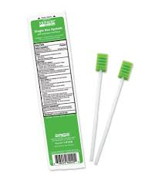
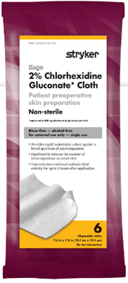
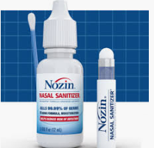
What to Expect at the Hospital Before Surgery
ERAS HEALS
Education & Empowerment
Mouth Care Swabs – These antiseptic mouth swabs may be provided to
you before surgery to help clean your mouth. This can also help to prevent pneumonia
after surgery.
Chlorhexidine Gluconate (CHG) Soap – Antibacterial wipes will be provided to you at the hospital prior to surgery for a final skin cleansing. These wipes have the same soap that you were asked to wash with at home and will help to significantly reduce the number of microorganisms on your skin.
Antiseptic Nasal Swabs – These antiseptic swabs will be provided to you prior to surgery to help reduce bacteria in your nose that can potentially cause skin infections.

Slide 8
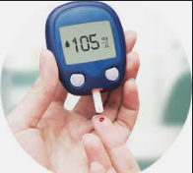

What to Expect at the Hospital Before Surgery
ERAS HEALS
Education & Empowerment
We will check your blood sugar level before surgery with a small finger stick.
High blood sugar levels (Hyperglycemia) can increase the chance of surgical site infections and also can slow down wound healing.
If your blood sugar is over 140mg/dL before, during or after surgery we may give you an injection of medicine to help lower your blood sugar.
Your healthcare team will check to make sure you were able to do the following at home to prepare for surgery:
  Drink your clear carbohydrate Pre-Surgery drink 3 hours prior to your arrival time
  Use your CHG soap the night before and morning of surgery (Joint Works follow protocol)

Slide 9

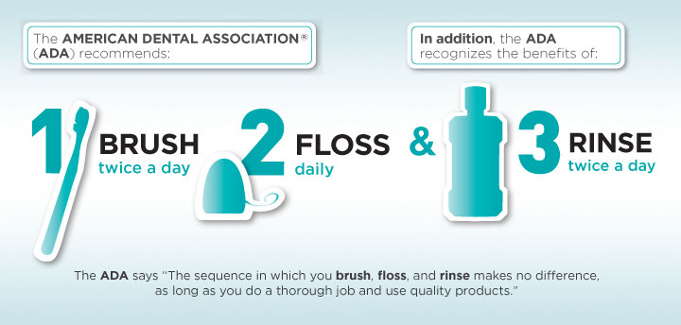
Mouth Care
ERAS HEALS
Healthy Habits
Without routine brushing, harmful bacteria can rapidly multiply in your
mouth. These bacteria may travel into your lungs and cause pneumonia,
a serious and potentially life-threatening infection.
The American Dental Association suggests brushing your teeth twice a day
with a soft-bristled brush and rinsing with mouthwash. Flossing daily can
help reduce the bacteria between teeth where your brush can’t reach.
Be sure to brush your teeth, floss and rinse
with mouthwash everyday—even the
morning of surgery

Slide 10
Surgical Site Infections
ERAS HEALS
Healthy Habits & Hand washing
Our skin is the largest organ of our body One of the many functions of the skin is to prevent dirt, bacteria and viruses from getting inside our body. All of us have millions of microorganisms on our skin, and if our skin is cut, microorganisms can get in and cause an infection.
Because incisions will be made through your skin for surgery, you are at a higher risk for infection. There are many things you can do to help prevent the chance of infection.
Wash your hands or use hand sanitizer
Do not touch your incisions
after surgery
Do not shave 48 hours before surgery, except for your face
Use the CHG soap provided
to you

Slide 11
What is a Surgical Site Infection (SSI)?
ERAS HEALS
Healthy Habits & Hand washing
After surgery, an infection can develop in the part of the body where
surgery took place—this is called a surgical site infection. Most patients
who have surgery do not develop an infection. Although rare, SSIs can be
serious. We want all patients to be aware of the possibility of an SSI and take preventive actions.
Some common SSI symptoms include:
Cloudy fluid that drains from your surgical wound
Fever
Pain, redness, and warmth around the surgical area
As your body heals, it is normal to see some redness, bruising, and swelling at your incision. Do not be alarmed.
If redness and swelling are concerning, or associated with pain, fever or cloudy fluid draining from your incision, please call your doctor for further instructions.

Slide 12
Preparing Your Skin
ERAS HEALS
Skin Prep
Preparing your skin before surgery can help reduce the risk of a surgical site infection by
removing the bacteria that is normally on our skin or found in the environment. You have been
provided Chlorhexidine Gluconate (CHG) which is a special soap used before surgery. Please
follow the instructions on the following page to use your CHG soap.
Ensure after you bathe, you put on clean, freshly laundered pajamas and
sleep on clean freshly laundered sheets. In the morning, put on clean,
freshly laundered comfortable clothing.
Do not apply any lotions, creams, skin or hair products after using CHG.
Plan to shower with CHG on the day of your surgery no more than an
hour before you plan to leave your house.
Also, if you have pets, please do not allow them to sleep in bed with you
the night before surgery.

Slide 13
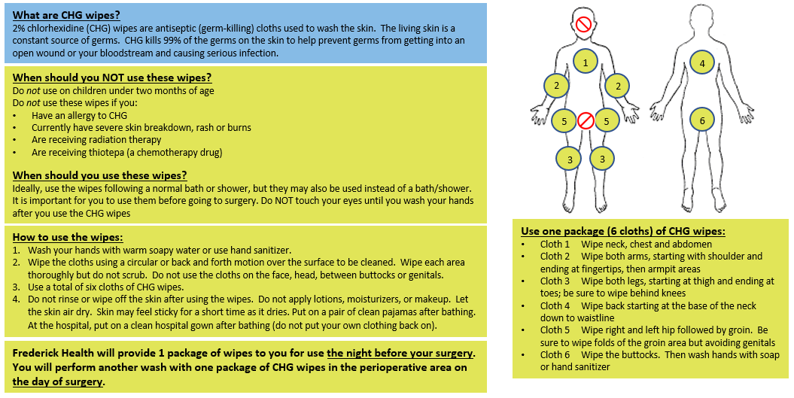
Preparing Your Skin
How to bathe or shower with CHG
ERAS HEALS
Skin Prep

Slide 14
Deep Breathing
ERAS HEALS
Lungs
To help prevent complications after surgery such as pneumonia, it is important to take deep breaths before and
after surgery. An incentive spirometer is a device that will help you expand your lungs. You will receive this
when you arrive at the hospital for surgery. It is important to use this as instructed to keep your lungs expanded and clear.
Although you won’t receive your Incentive Spirometer (IS) until you arrive at the hospital for your surgery, there are a few important deep breathing exercises you can do at home. Please do the following breathing exercises 10 times when you wake up in the morning, and 10 times before you go to sleep at night Do this each day before your surgery:
Sit in a chair or on the edge of your bed with your back straight.
Inhale slowly and as deeply as you can.
Hold the air in for 3-5 seconds.
Slowly let the air out.
Repeat approximately 10 times.
You do not have to do 10 in a row. If you begin to feel lightheaded or dizzy, take a break and continue
in a few minutes or when you feel better.

Slide 15
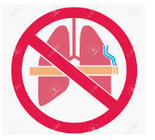

Quit Smoking
ERAS HEALS
Lungs
If you smoke or vape, plan to quit smoking as soon as you know you may need to have surgery. The sooner you quit smoking before surgery, the more benefits there are.
Smoking can increase your risk of surgical complications. These complications include:
Increased risk of lung problems such as pneumonia
Increased risk of heart problems such as high blood pressure, heart rate and risk of irregular heartbeat (arrhythmias)
Decreased oxygen in your blood
Increased risk of blood clots
Increased risk of wound complications such as delayed healing, wound infections, cell and tissue death and hernias at the wound site
When should you quit?
Before surgery is the best time to quit—the quit rate is much higher for those who quit before surgery
Quitting 8 weeks before surgery can help improve your airway function
Quitting 4 weeks before surgery can help decrease your surgical complication rate by 20-30%
Quitting 1 day before surgery can help improve your blood pressure and heart rate

Slide 16

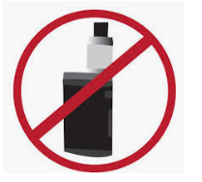
Resources to Quit Smoking
ERAS HEALS
Lungs
Call the Quit Line at 1-800 QUIT NOW
(1-800-784-8669)
Government Quit Smoking Resources:
https://teen.smokefree.gov/
https://espanol.smokefree.gov/
https://women.smokefree.gov/
https://veterans.smokefree.gov/
https://smokefree.gov/
https://60plus.smokefree.gov/
American Lung Association
www.lungusa.org
Center of Disease Control
www.cdc.gov/tobacco/state_system/index.htm
National Cancer Institute Tobacco line
1-877-448-7848 (also in Spanish)
American Society of Anesthesiologists
www.asahq.org/stopsmoking/provider

Slide 17

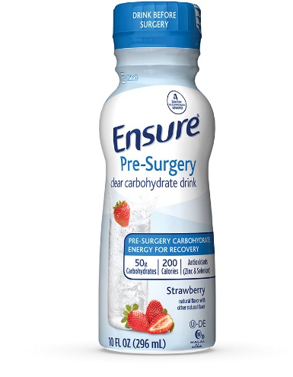
Diet and Nutrition
ERAS HEALS
Appetite
In the days or weeks prior to surgery:
Eat a balanced diet with foods that will help your body heal after surgery. This includes foods high in protein, whole grains, fruits,
and vegetables. This will help to reduce the risk of infection and promote healing of your surgical incisions.
You can also include supplements in your diet such as Ensure or Glucerna to help improve your nutrient intake prior
to surgery.
Stay hydrated leading up to surgery and be sure to drink plenty of fluids the day before surgery – unless you have a fluid
restriction from your doctor.
You may continue to drink clear liquids to stay hydrated (water, clear juice, Gatorade, black coffee or tea – NO milk) even once
you have stopped eating solid food.
Three (3) hours before your arrival time:
Drink your clear Pre-Surgery carbohydrate drink (16 oz apple, cranberry juice or 12 oz grape juice if you cannot find Ensure) if one was provided to you—drink this right away (within 5 minutes if possible). This will be your last drink and must be finished three (3) hours before your hospital arrival time.
If you have diabetes or gastroparesis, please ask your surgeon if you should drink a carbohydrate beverage.
Three (3) hours before hospital arrival you must have nothing by mouth (no food or drink), and should not have candy, cough drops,
or gum—or your surgery will have to be delayed or rescheduled.

Slide 18
Diet and Nutrition – After Surgery
After surgery your doctor may start you on clear liquids. If you are going home the same day,
you may be given a light snack, such as juice and crackers, before you leave the hospital. Your
discharge instructions will let you know if there are any diet restrictions you must make after surgery.
Your doctor may want you to chew gum after surgery. Gum will help to prevent ileus. This is a stoppage or blockage in the intestine where you have had surgery. Your doctor may want you to bring gum with you to the hospital if you require an inpatient stay.
If you require an inpatient stay after surgery, your surgeon may wait until you experience a return of bowel function (when you begin to pass gas) before advancing your diet from clears, toward a low-fiber or regular diet.
Your doctor may suggest you drink supplements, such as Ensure or Glucerna. These can help provide vitamins and nutrients that help with wound healing. To help in consuming these supplements:
Try drinking your supplements between meals as a snack
Drink your supplement instead of water with medications
Use supplements instead of milk with cereal or coffee

Slide 19

Activity – Before & After Surgery
ERAS HEALS
Activity
Prior to surgery, it is important to be active. If you are able to, walk at least
30 minutes, three days a week in the days and weeks leading up to your
surgery. Walk more if you are able to or participate in other moderate intensity activities.
After your surgery, it is important to get out of bed and be active. Being active will help:
Prevent blood clots from forming
Prevent lung infections such as pneumonia
Assist in the return of normal bowel function after surgery
Help you get back to your baseline daily activities sooner

Slide 20
Activity After Surgery
ERAS HEALS
Activity
General activity time frames for you to anticipate after surgery are below. Your safety
is our number one priority. If you ever feel dizzy or light-headed, please do not get out
of bed without assistance. Remember: Call, Don’t Fall! Use your call bell to ask for assistance to the bathroom or out of bed when not feeling well—even if you have previously been up and walking on your own.
Minimum Activity Guidelines After Surgery – If you are staying in the hospital
When in bed:
Elevate head of the bed 30 degrees or more
Flex your feet and move your arms and legs while awake
The automatic compression stockings on your legs should be applied and turned on
6-8 hours after surgery:
Ask for assistance to get out of bed and sit in a chair
Walk at least once
Flex your feet and move your arms and legs while awake
First day after surgery through to discharge:
Walk in the hallway a minimum of two times the first day – more if tolerated
Each day after, walk freely as much as you can (at least three times a day)
Take all meals out of bed in a chair

Slide 21
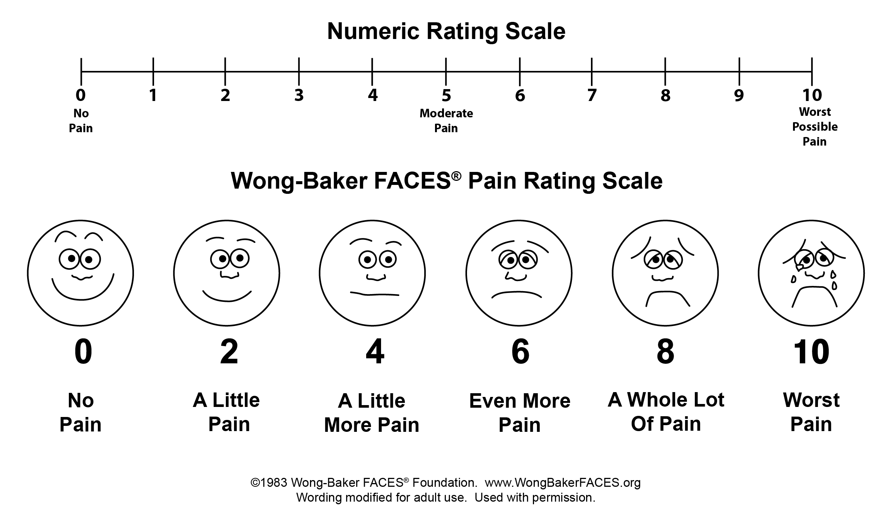
Pain Control
ERAS HEALS
Education & Empowerment
To help you recover after surgery, it is important to control your pain. If you experience a lot of pain, you will be less likely to participate in your recovery such as eating, drinking, walking and taking deep breaths.
We will help you with your pain using something called “multimodal pain control”. This multimodal approach uses two (2) or more medications with different pain control mechanisms to help to control pain while using less narcotic medication. Narcotics can cause nausea and vomiting and can slow down your bowel function—this slows down your recovery.
You can help us by letting your healthcare team know your pain rating. It is important not to wait until your pain is severe before asking for pain medication. Controlling pain will help ensure you continue to play an active role in your recovery.

Slide 22
Leaving the Hospital
ERAS HEALS
Education & Empowerment
Planning for your discharge from the hospital is an important part of your surgery. There are certain goals you must reach so that you can be safely discharged from the hospital, and your medical team will work with you to help you reach these goals. Our healthcare professionals and the rest of your team will help you plan for this transition.
General Discharge Criteria:
Tolerate the diet your physician prescribed to you
Drink all the liquid your body needs without feeling sick
Pass gas
Manage your pain with oral pain medicine only
Get out of bed and walk without help

Slide 23
Leaving the Hospital
ERAS HEALS
Education & Empowerment
Everybody meets discharge criteria at slightly different times. Different surgeries, and different surgical approaches may need more or less time in the hospital. And for some surgeries you can go home the same day. Some general guidelines are below, but please talk with your surgeon about expectations for your surgery, or surgeries not listed below:
Minimally invasive (Laparoscopic / Robotic): 0-2 days
Open: 1-3 days

Slide 24
Now That You Are Home
ERAS HEALS
Education & Empowerment
Follow your discharge instructions and the instructions below to continue
your healing at home.
Activity:
After surgery you should not operate heavy machinery, drive a motor vehicle, or consume alcohol until cleared by your surgeon or primary care physician.
Do not spend the whole day in bed. Be sure to get up and walk every hour during the daytime to prevent blood clot formation. During your follow up visit, check with your provider about when to return to specific athletic activities.
Use the incentive spirometer 10 times an hour while awake. This is exercise for your lungs.
Stay well hydrated by drinking water.
Eat a healthy diet. Be sure to follow any dietary restrictions your doctor may have given you.

Slide 25
Now That You Are Home
ERAS HEALS
Education & Empowerment
Follow your discharge instructions and the instructions below to continue
your healing at home.
Wound Care Instructions:
Always clean your hands with soap and water or an alcohol-based hand rub before and after caring for your surgical incision(s).
Do not allow pets too close to your surgical incision(s).
Do not apply any ointments or lotions unless specifically instructed to do so by a provider.
No pools, baths, or soaking of the surgical incision(s) until surgical incision(s) are healed unless specifically instructed to do so by a provider.
Family and friends who are visiting should clean their hands with soap and water or an alcohol-based hand rub before and after visiting.

Slide 26
Resources
ERAS HEALS
CDC (n.d.) Frequently asked questions: Surgical Site Infections.
Retrieved from https://www.cdc.gov/HAI/pdfs/ssi/SSI_tagged.pdf
American Dental Association (2022). Mouth healthy: Brushing your teeth. Retrieved from https://www.mouthhealthy.org/en/az-topics/b/brushing-your-teeth
Johns Hopkins Medicine (2022). CHG Bathing to Prevent Healthcare Associated Infections. Retrieved from https://www.hopkinsmedicine.org/health/treatment-tests-and-therapies/chg-bathing-to-prevent-healthcareassociated-infections
American College of Surgeons (2020). Quit smoking before your operation. Retrieved from https://www.facs.org/media/jxbpufci/quit_smoking.pdf

Slide 27

Notes

Slide 28
Skin Preparation
Instructions – Wipes

