Slide 1
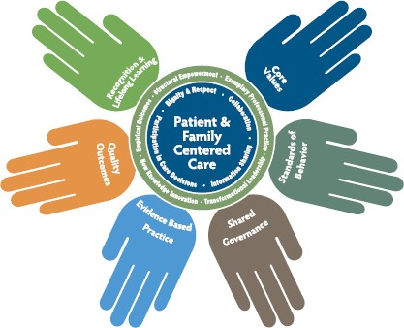
Frederick Health
2022-2025 Nursing Strategic Plan
FH Nurses: Committed to Excellence
Demonstrate Transformational Leadership
Promote workplace diversity, equity, and inclusion.
Strengthen clinical nurse advocacy for resources specific to nurse well-being.
Invest in leadership development that emphasis nurses as leaders at every level of the organization
Support nurses' well-being by strengthening shared governance and integration of the professional practice model
Strengthen Structural Empowerment
Improve patient outcomes by ensuring nurses participate in interprofessional decision-making groups
Promote continuous learning and professional growth for a highly skilled nursing workforce.
Support nurses at all levels to engage in population health and outreach activities
Establish a Culture of Exemplary Professional Practice
Strengthen professional practice through advancing shared governance and nursing professional practice
Promote initiatives that enhance nursing engagement
Promote a positive patient experience environment through advancing Patient & Family Centered Care and Culture of Safety
Facilitate a Culture of New Knowledge, Innovations,
& Improvements
Improve the delivery of nursing care and outcomes through the promotion of research and EBP in nursing culture.
Establish nursing innovations through a supportive culture of evidence-based practice and research.
Establish a research-based review process for nursing practice related policies.
FH Nursing Mission: To be leaders in providing compassionate, quality, evidence-based care focused on the unique individual needs of our patients and their families
FH Mission: To positively impact the wellbeing of every individual in our community

